Slide 1

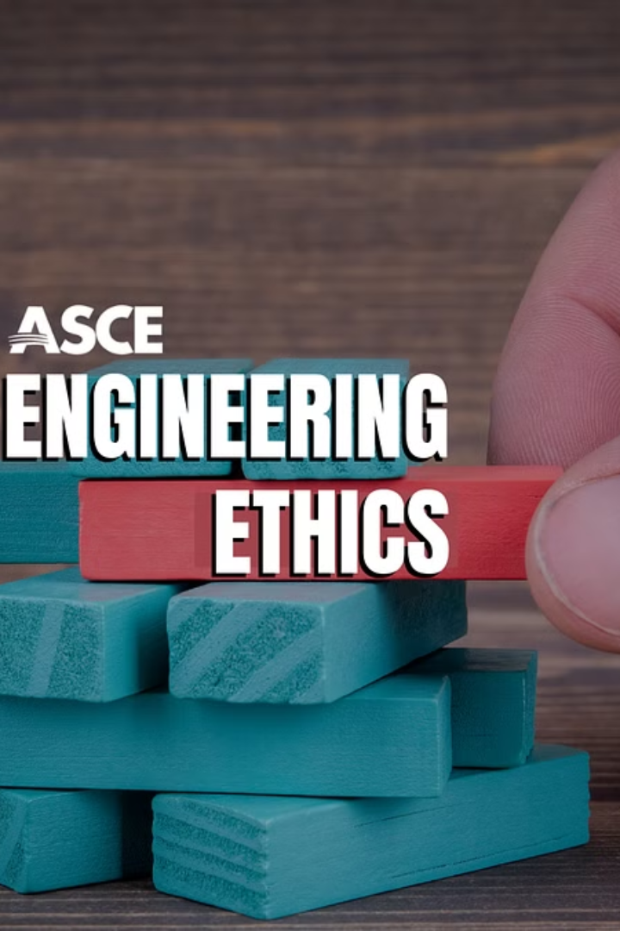
Introduction to Rules and Ethics
Understanding the importance of following ethical norms and regulations in engineering is crucial for maintaining professional integrity and public trust.
BY
RAKSHITA PANT
RAHUL PANDEY
RAHUL YADAV
RAJ THAKUR
RIYA
ROHIT
NEERAJ JOSHI

Slide 2
Importance of Adhering to Basic Rules
1
First and Foremost
2
Maintaining Order
3
Enhancing Safety
Basic rules form the foundation for a safe and efficient engineering environment.
Adhering to these rules ensures consistency and adherence to quality standards.
Strict compliance with basic rules is essential to ensuring the safety of personnel and assets.

Slide 3
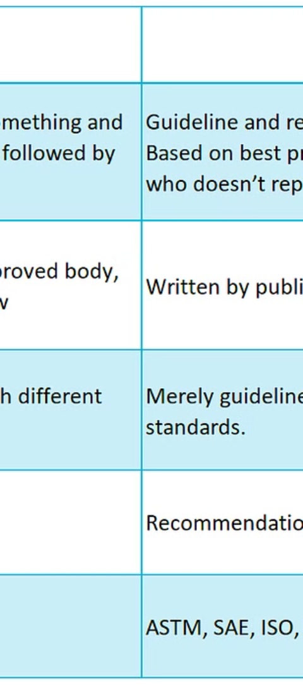
Understanding Laws and Regulations for Engineers
1
Licensing Requirements
Engineers need to understand and meet the licensing requirements in the regions they operate in.
2
Environmental Regulations
Compliance with environmental laws is essential to avoid legal repercussions.
3
Health and Safety Standards
Knowing and following health and safety regulations is imperative to maintain a secure workplace environment.

Slide 4
Ethical Norms in Engineering Practices
Integrity and Honesty
Conflict of Interest
Transparency
Transparency in engineering work builds trust and credibility with stakeholders.
Engineers are expected to act with honesty and integrity in their professional dealings.
Avoiding conflicts of interest ensures unbiased judgment and decision-making.

Slide 5



Consequences of Violating Rules and Ethics
Legal Ramifications
Public Trust Erosion
Negative Impacts on Projects
Violating regulations can lead to legal issues and damage the engineer's reputation.
Loss of trust due to ethical violations can adversely impact an engineer's career and the organization's reputation.
Violations can lead to project delays, cost overruns, and compromised safety.

Slide 6



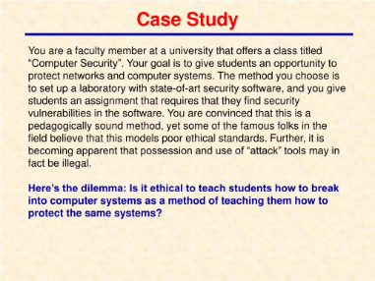
Case Studies on Ethical Dilemmas in Engineering
Moral Choices
Professional Integrity
Educational Insights
Case studies provide insight into making morally sound decisions in complex situations.
Analysing real-life cases instils the importance of upholding professional ethics.
Through analyzing cases, engineers learn valuable lessons for ethical decision-making.

Slide 7
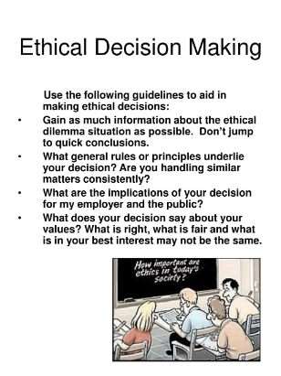
Implementing Ethical Decision-Making in Engineering
Ethical Framework
Continuous Education
Peer Review Mechanisms
Developing and following an ethical framework supports consistent decision-making.
Training on ethical decision-making reinforces its integration into engineering practices.
Peer reviews help assess ethical implications and adherence to professional norms.

Slide 8
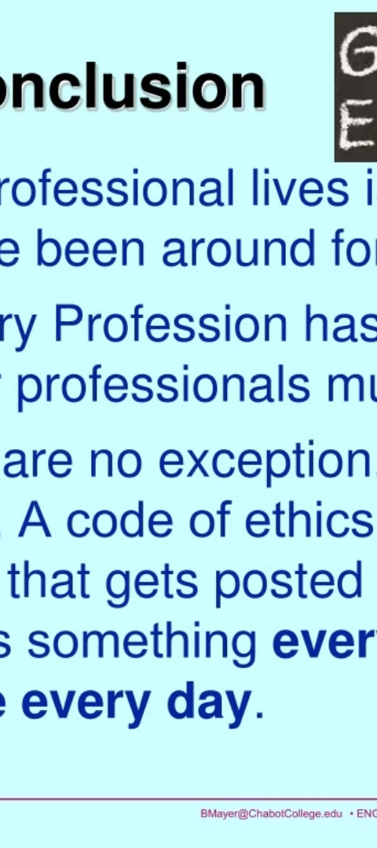
Conclusion and Key Takeaways
1
Ethics is Fundamental
2
Indispensable Skill
Adhering to rules and ethics is fundamental to the sustainability of engineering practices.
Developing ethical decision-making is indispensable for the professional growth of engineers.
3
Positive Impacts
High ethical standards positively influence project success and professional reputation.

Slide 9
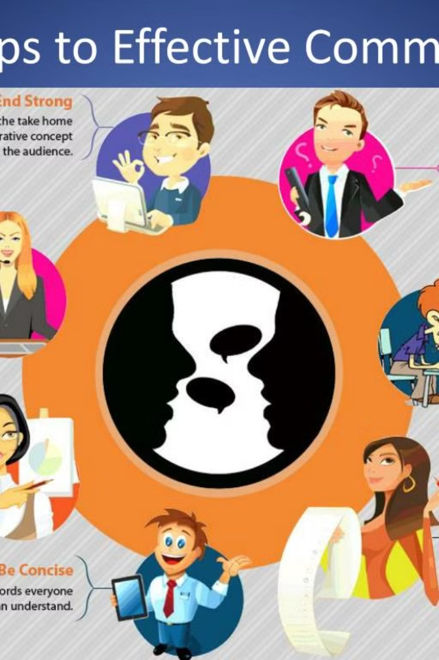
Effective Communication
Effective communication is the cornerstone of successful interactions and relationships. It encompasses various elements such as reading, active listening, speaking, writing, presentation techniques, seminars, and group discussions.

Slide 10
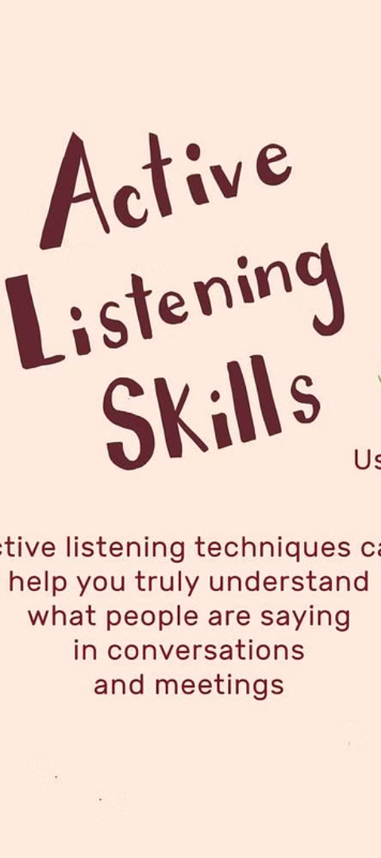
Reading & Active Listening Skills
1
Understanding
2
Engagement
Developing the ability to comprehend written and spoken information.
Practicing active listening to truly connect and understand others.
3
Skill Enhancement
Improving reading speed and retaining valuable information.

Slide 11
Writing
1
Clarity & Coherence
Structuring ideas in a logical and coherent manner.
2
Grammar & Style
Understanding language mechanics to enhance writing quality.
3
Editing & Revision
Refining content through thorough editing and revision processes.

Slide 12



Speaking
Public Speaking
Clarity
Confidence
Mastering the art of delivering impactful speeches and presentations.
Communicating thoughts and ideas clearly and effectively.
Projecting self-assurance and poise in verbal communication.

Slide 13

Presentation Technique/Seminar
Engagement
Visual Aid Utilization
Captivating the audience through interactive sessions.
Effectively incorporating multimedia to enhance engagement.
Storytelling Skills
Mastering the art of narrative to convey key messages.

Slide 14




Group Discussion
Collaboration
Interacting and sharing ideas in a group setting.
Active Participation
Engaging in meaningful discussions and contributing constructively.
Conflict Resolution
Resolving differing perspectives through effective communication.

Slide 15

Overcoming Communication Barriers
Empathy
Cultural Sensitivity
Active Listening
Understanding and empathizing with diverse perspectives.
Respecting and understanding cultural nuances for effective communication.
Developing crucial skills to understand others' viewpoints and experiences.

Slide 16

Conclusion and Key Takeaways
Effective Communication Skills
Are Vital for Personal & Professional Growth
Constant Improvement is Key
Embracing feedback and practicing consistently leads to mastery

